Slide 1
Data Mining (K-Medoid)
BY
Adnan Amin

Slide 2
K-Medoids Clustering Algorithm
K-Medoids (also called as Partitioning Around Medoid) algorithm was proposed in 1987 by Kaufman and Rousseeuw.
Partitioning around medoids (median)
Slightly modified from the K-means algorithm.
The difference between mean and median.
Where mean indicates the average value of all data items collected
And median indicates the value around that which all data items are evenly distributed around it.

Slide 3
Basic Idea
First compute the K representative objects which are called as medoid.
After finding the set of medoids, each object of the data set is assigned to the nearest medoid.
Object i is put into

Slide 4
The algorithm proceeds in two steps:
BUILD-step: This step sequentially selects k "centrally located" objects, to be used as initial medoids
SWAP-step: If the objective function can be reduced by interchanging (swapping) a selected object with an unselected object, then the swap is carried out. This is continued till the objective function can no longer be decreased.

Slide 5
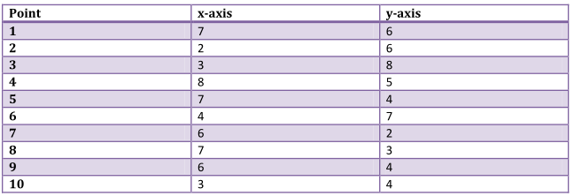
For Example: for a given k=2 clusters
Let us choose that (2,4) and (7,4) are the medoids.
Find the distance between each point with chosen medoids

Slide 7

So, now after the clustering, the clusters formed are:
{(3,4), (2,6), (3,8), (4,7)} and
{(7,4), (6,2), (6,4), (7,3), (8,5), (7,6)}.
Now calculating the cost which is nothing but the sum of distance of each non-selected point from the selected point which is medoid of the cluster it belongs to.

Slide 8
So, now let us choose some other point to be a medoid instead of (7, 4).
Let us randomly choose (7, 3).
Not the new medoid set is: (3, 4) and (7, 3).
Now repeating the same task as earlier:
So, now if we calculate the distance from each point:

Slide 9
Calculating the total cost =
cost((3, 4), (2, 6)) + cost((3, 4), (3, 8)) + cost((3, 4), (4, 7)) + cost((7, 3), (7, 6)) + cost((7, 3), (8, 5)) + cost((7, 3), (6, 2)) + cost((7, 3), (7, 4)) + cost((7, 3), (6, 4))
= 3 + 4 + 4 + 3 + 3 + 2 + 1 + 2
= 22.
The total cost when (7, 3) is the medoid > the total cost when (7, 4) was the medoid earlier.
Hence, (7, 4) should be chosen instead of (7, 3) as the medoid. Since there is no change in the medoid set, the algorithm ends here. Hence the clusters obtained finally are:
{(3,4), (2,6), (3,8), (4,7)} and{(7,4), (6,2), (6,4), (7,3), (8,5), (7,6)}.

